Slide 1
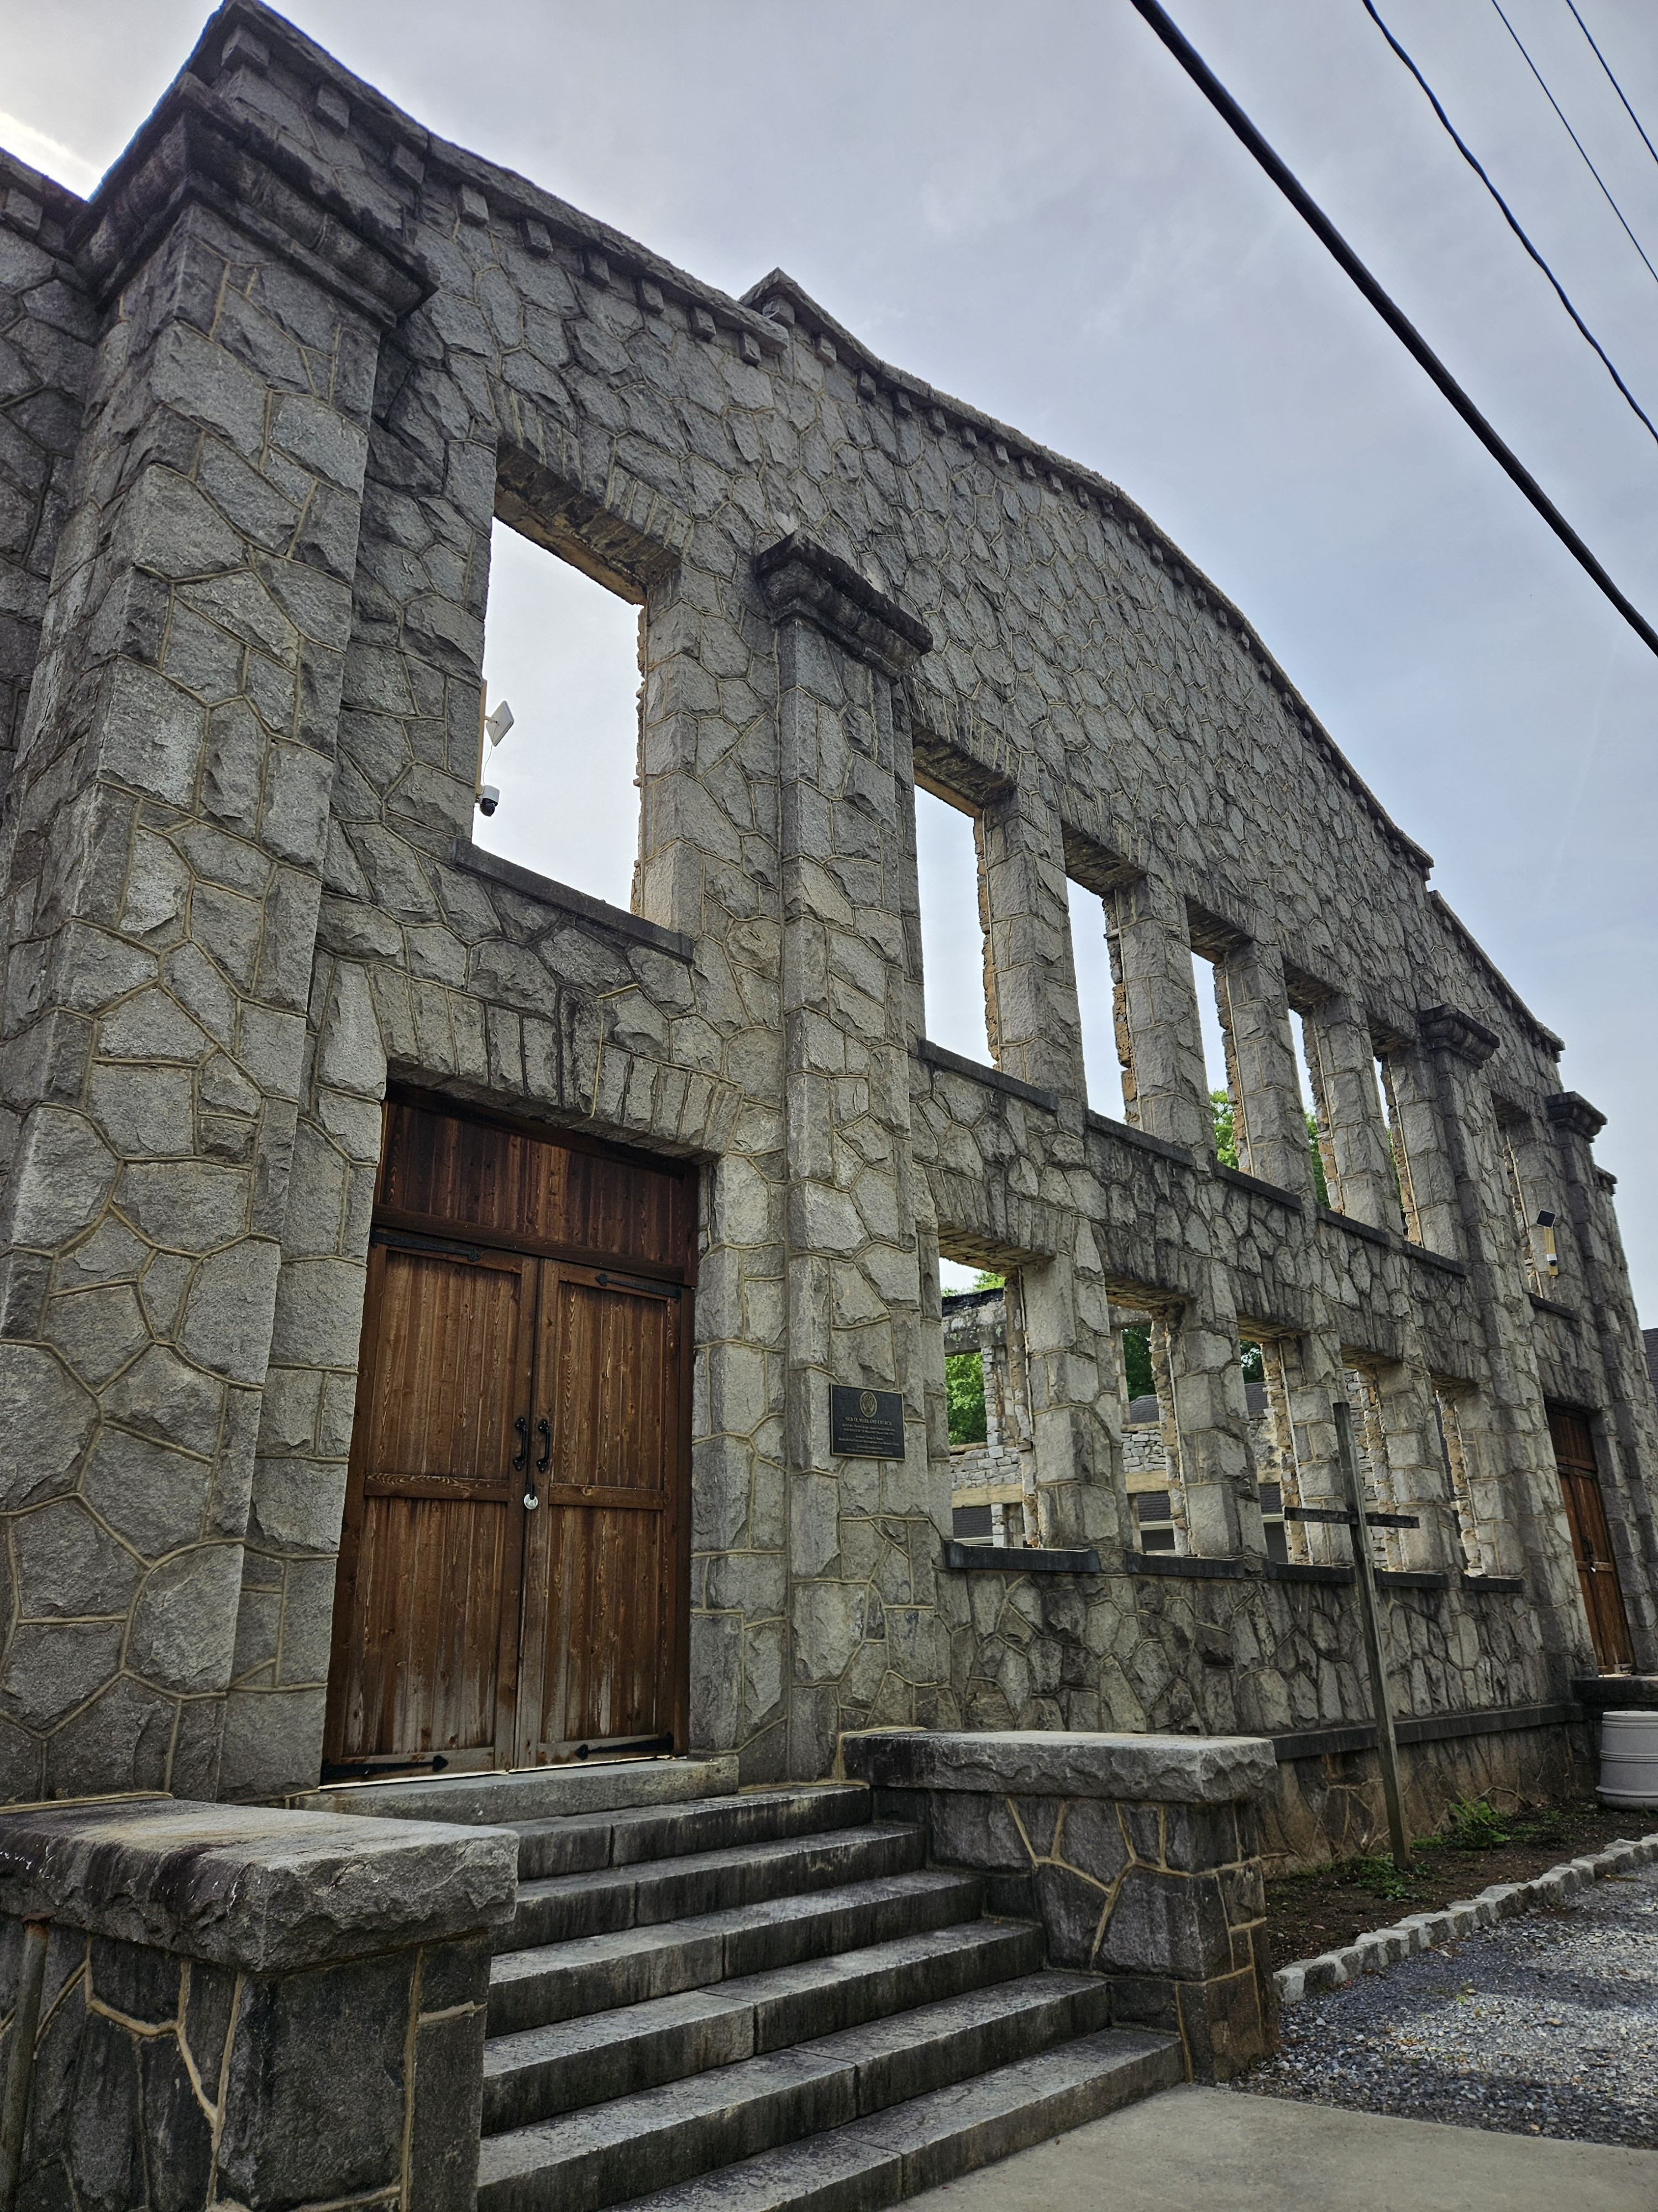
ENGLISH AVENUE · HISTORIC WESTSIDE · ATLANTA, GEORGIA
St. Mark Agora
Historic St. Mark’s AME Church
Atlanta's Most Extraordinary
Venue & Event Destination
Venue Rental
Special Occasions
Arts & Culture
Event Sponsorship

Slide 2
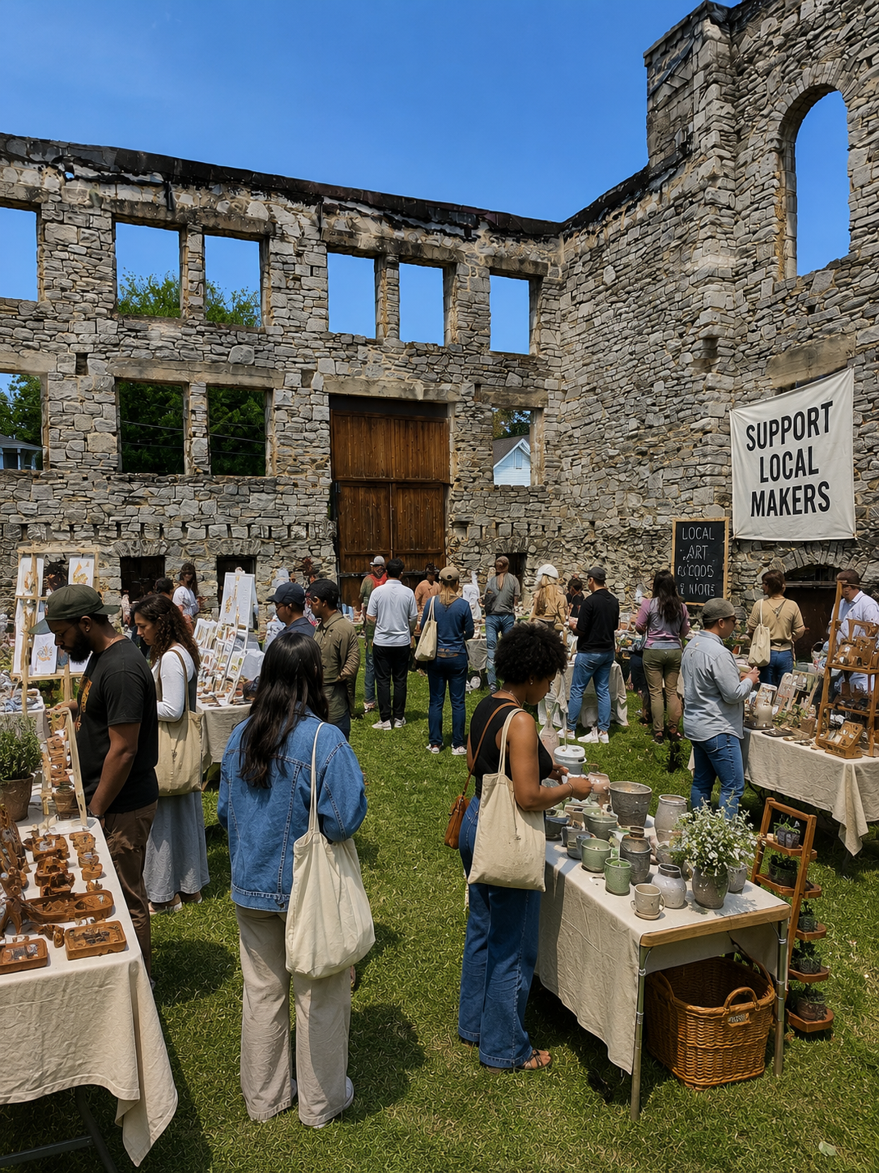
THE VENUE
Where History Meets
the Moment
Old St. Mark's AME Church is a one-of-a-kind event venue on Atlanta's Historic Westside. Built from hand-laid stone over a century ago, the space offers dramatic architecture, an open-air interior courtyard, and a story that no hotel ballroom or event center can replicate.
Whether you're hosting 50 guests or 500, Old St. Mark's gives every event an unforgettable backdrop.
Historic
Stone Architecture
Open-Air
Interior Courtyard
Minutes from
Downtown Atlanta
Flexible
Event Spaces

Slide 3
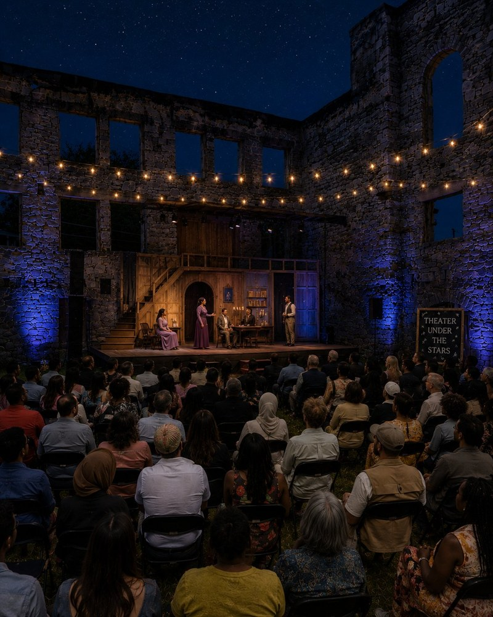
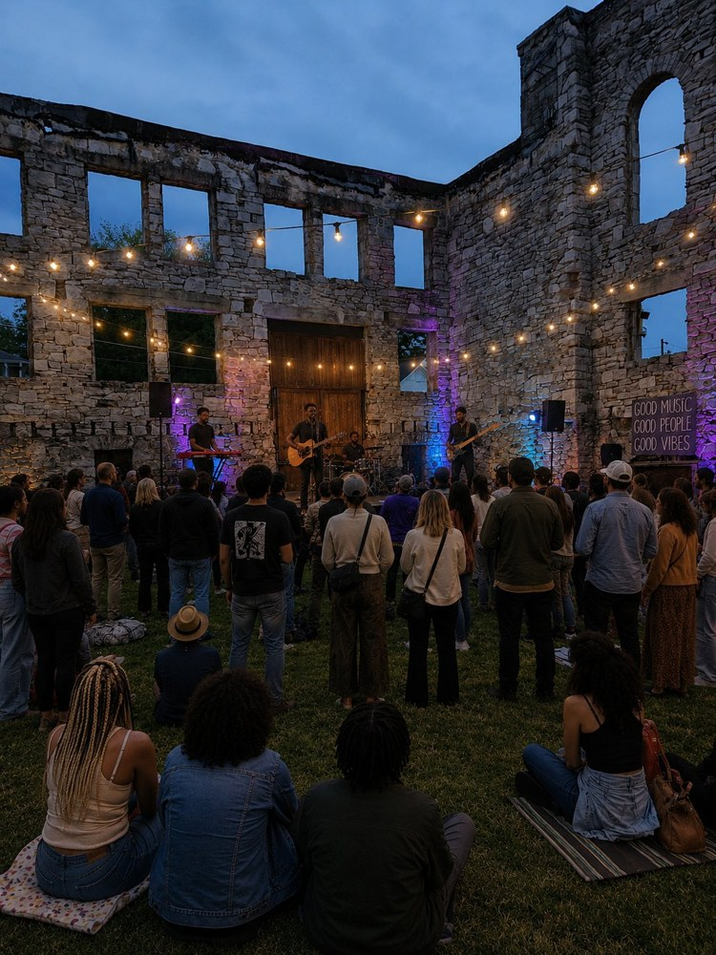
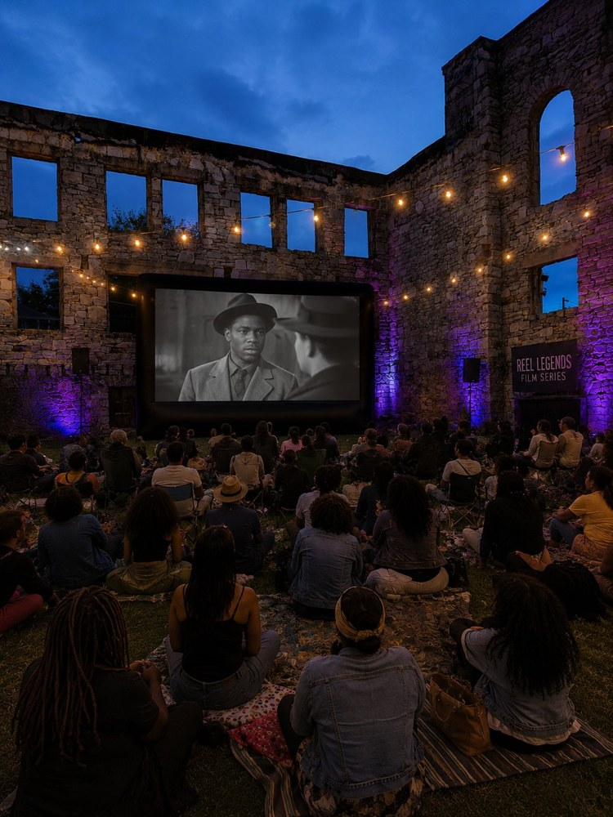
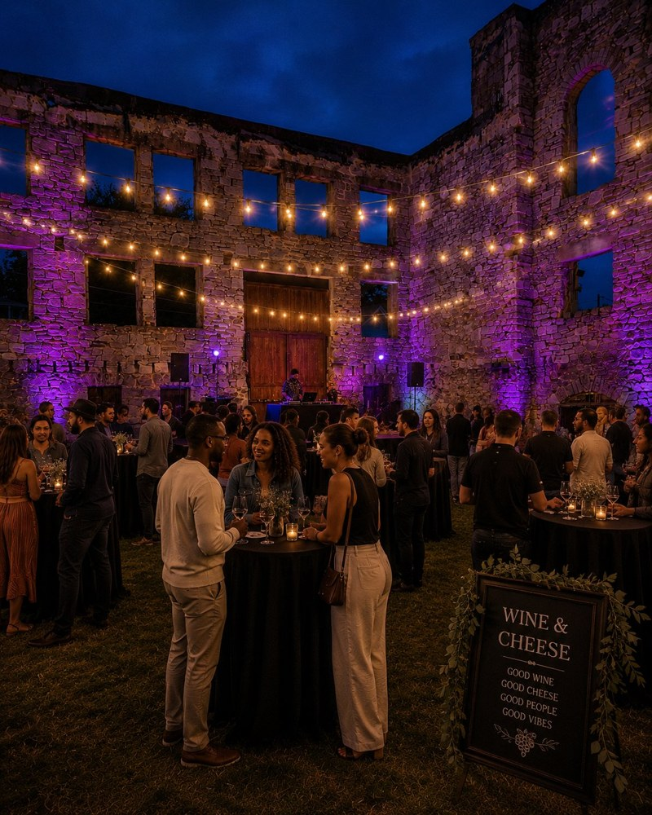
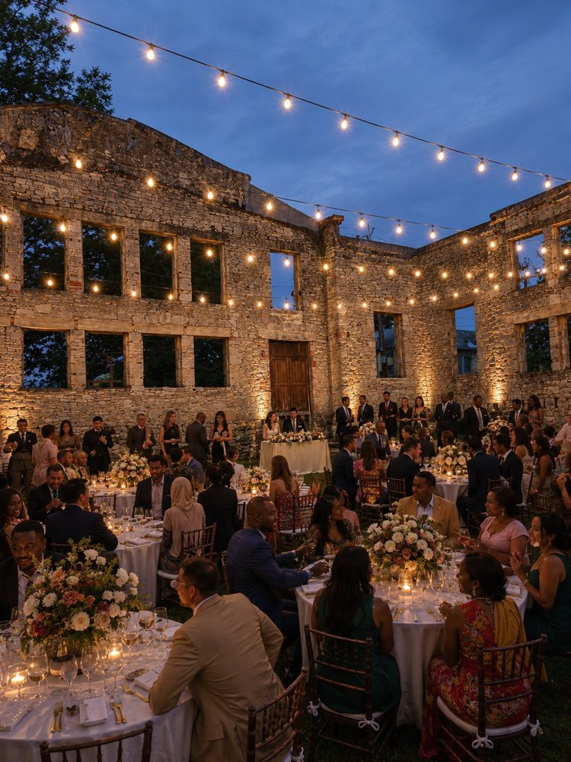
THEATER UNDER THE STARS
LIVE MUSIC
FILM SCREENINGS
ST. MARKS AGORA
ATLANTA'S WESTSIDE
A historic stone ruin reimagined as Atlanta's most
unforgettable open-air cultural venue.
WINE & SOCIAL
PRIVATE EVENTS

Slide 4
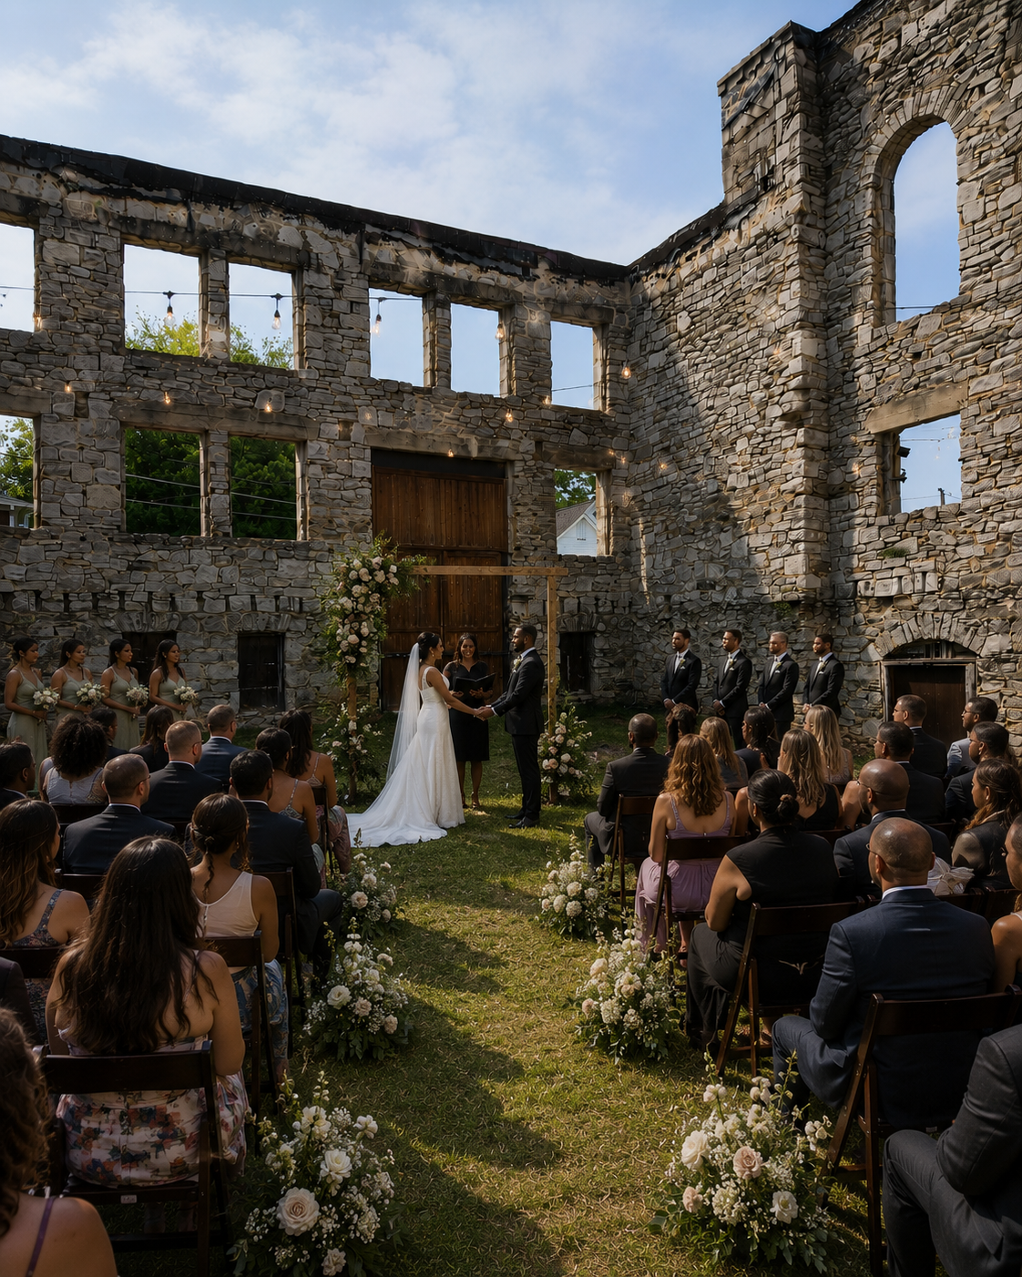
Book the Space.
Own the Moment.
PERFECT FOR
VENUE RENTAL &
SPECIAL OCCASIONS
Every Occasion Deserves
an Extraordinary Setting
Weddings & Receptions
An iconic stone backdrop for life's most memorable moments. Ceremonies, receptions, and intimate dinners.
Concerts & Live Music
Outdoor and semi-outdoor performances in a natural acoustic setting unlike any other in Atlanta.
Art Exhibitions & Galas
Gallery openings, cultural showcases, benefit dinners — the space becomes part of the art.
Corporate & Private Events
Off-site meetings, team retreats, brand activations, and milestone celebrations.
Film & Media Productions
Location shoots, premieres, and screenings with unmatched architectural character.
Theater Under the Stars
Inquire about availability & pricing →
Old St. Mark's is available for private and public events. A backdrop no other Atlanta venue can offer.
Live Immersive Theater.

Slide 5
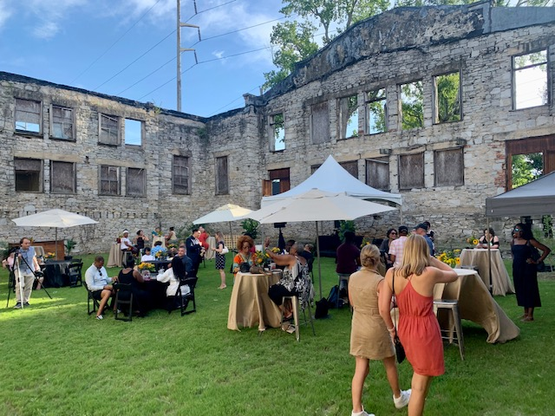
THE VENUE
Where History Meets
the Moment
Old St. Mark's AME Church is a one-of-a-kind event venue on Atlanta's Historic Westside. Built from hand-laid stone over a century ago, the space offers dramatic architecture, an open-air interior courtyard, and a story that no hotel ballroom or event center can replicate.
Whether you're hosting 50 guests or 500, Old St. Mark's gives every event an unforgettable backdrop.
Historic
Stone Architecture
Open-Air
Interior Courtyard
Minutes from
Downtown Atlanta
Flexible
Event Spaces

Slide 6
PROGRAMMING
What's On at The Mark
Spring / Summer
Fall
Year-Round
Sounds at St. Mark's
Spoken Word at the Stone
Film Screenings
Concert Series
Poetry & Spoken Word
Outdoor Cinema
Monthly
Monthly
Bi-Monthly
Walls & Works
Dance Under Open Sky
Private Venue Rental
Art Exhibition
Dance Performance
Special Events
Quarterly
October
Open Booking
Westside Market & Fest
Next Gen at St. Mark's
Weddings & Receptions
Community Festival
Youth Arts
Special Occasions
May & July
Year-Round
By Appointment

Slide 7
THE MARKETPLACE VISION
Where Business Meets
Purpose
St. Mark Marketplace mirrors the ancient Agora—the public square where commerce, daily life, and gospel ministry naturally overlapped.
💰 Economic Dignity
Creating space for local vendors replaces charity with opportunity—allowing residents to build wealth and self-reliance.
⛪ Incarnational Presence
Instead of asking the community to come to us, we bring a thriving, loving ecosystem to where they already shop and gather.
✨ Holistic Flourishing
Addressing physical poverty (lack of resources) and spiritual poverty (lack of hope) under one roof—true Shalom.

Slide 8
From Scarcity to Flourishing
Using intentional spatial design to shift the community’s mindset (Romans 12:2)
Abandoned → Abundant
THE ENTRANCE: Beauty, warmth, and excellent lighting from the first step inside. High-quality aesthetics signal that residents deserve first-class spaces.
Isolation → Connection
THE GATHERING SPACE: Repurpose the old sanctuary into central seating and dining that encourages conversation and collaboration.
→
Consumer → Creator
THE INCUBATOR STALLS: Ultra-low-cost micro-stalls for first-time entrepreneurs break the mindset of dependency and spark local imagination.
Surviving → Thriving
THE OUTCOME: A community transformed from a survival mindset to one of hope, imagination, and abundant possibility.
→
MINDSET TRANSFORMATION
“At the heart of all that civilization has meant and developed is 'community.”
— Dr. Martin Luther King Jr.

Slide 9
THE MARKETPLACE BLUEPRINT
Functional Spaces for Impact
💻 The “Tentmaker” Coworking Space
Low-cost workspace with Wi-Fi for local freelancers, students, and remote workers. Named for Paul, Aquila, and Priscilla—who built community while working with their hands.
📚 Financial Literacy Hub
Free workshops on budgeting, entrepreneurship, and credit—hosted in an old classroom or vestry. Partners with local banks and universities. The “renewing of the mind” in practice.
🛖 Micro-Vendor Incubator Stalls
Ultra-low-cost, first-time vendor stalls alongside food and produce. Local artisans selling jewelry, clothing, pottery, and books. When residents see neighbors succeeding, everything changes.
🍽️ The Community Table
A subsidized cafe area offering healthy, affordable meals. Ensures the marketplace remains accessible to the most vulnerable neighbors while staying commercially viable.

Slide 10
ARTS & CULTURE INTEGRATION
The Arts Are Not Optional.
They Are the Engine.
🧠 Heals Scarcity Trauma
A survival mindset shuts down imagination. Art reawakens the brain’s ability to dream, hope, and think creatively.
📜 Rewrites the Story
A theatre stage and art gallery let the community reclaim its own narrative—showcasing beauty, talent, and resilience over deficit.
💸 Drives Commerce
Live music Fridays and community theatre bring foot traffic that directly increases vendor sales. Art and performance are economic engines.
🎭 The Sanctuary Stage
DAYTIME → Cafe seating and vendor dining
EVENING → Open-mic, jazz, theatre, spoken word
Local youth see people who look like them using their voices powerfully—proving their stories matter.
🖼️ The Living Gallery
Use the high walls, corridors, and stained-glass backdrops to display art by local residents and youth.
Hang art with price tags. When a local artist makes a sale, their mindset instantly shifts from “I am struggling” to “I am a professional creator.”
Partner with schools and nonprofits for youth art mentorship programs during weekdays.

Slide 11
WEEKLY PROGRAMMING BLUEPRINT
The St. Mark Agora Marketplace Week
MON – TUE
WED
THU
FRI
SAT
SUN
Incubation & Prep
Vendor restock
Coworking space open
Evening: Business Incubator classes
Wellness & Worship
Midweek Market 8AM-2PM
Youth arts workshops 3-5PM
Gospel choir + community dinner 6-8PM
Spoken Word & Ideas
Full market 11AM-7PM
Voices of the Community Open Mic 7:30-10PM
Jazz, Culture & Commerce
Daytime trade 11AM-6PM
Sanctuary Jazz Cafe + late vendors 7-11PM
Grand Bazaar & Theatre
Saturday Bazaar 9AM-4PM + outdoor market
Neighbourhood Theatre 5-7PM
Art Gallery Reception 7-9PM
Brunch & Rest
Shalom Brunch 11AM-4PM
Soul, jazz, or classical music background
Market closes 4PM
Key Rules
80/20 Audio: Low music during retail hours, full sound for evening events only.
Cross-Promotion: Route event attendees through vendor stalls on the way to their seats.

Slide 12
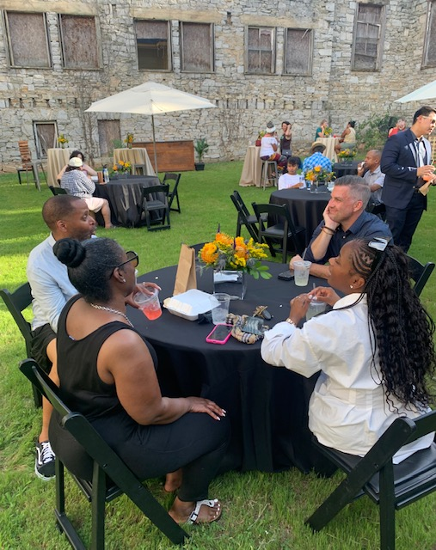
SPONSORSHIP
Put Your Brand
at the Center of
Atlanta Culture
Old St. Mark's draws Atlanta's most engaged audiences — arts lovers, community leaders, families, young professionals, and cultural tastemakers.
Sponsoring our events means your brand is woven into experiences people will remember.
4
6
ATL
Sponsorable
Event Series
Program
Categories
Historic
Westside

Slide 13
SPONSORABLE EVENTS
Four Series. Four Opportunities to Own the Stage.
CONCERT & LIVE MUSIC SERIES
ART EXHIBITION SERIES
Sounds at The Mark
Walls & Works
Monthly outdoor concerts — jazz, gospel, R&B, afrobeats, indie. A stage unlike any other in Atlanta.
Rotating gallery installations using the stone walls as canvas. Local and regional artists.
Monthly · Spring–Fall
Quarterly Exhibitions
POETRY & SPOKEN WORD SERIES
COMMUNITY FESTIVAL SERIES
Spoken Word at the Stone
Westside Market & Fest
Open mic nights, slam competitions, and curated showcases amplifying Atlanta's literary voices.
A community marketplace and cultural festival celebrating the food, art, music of the Historic Westside.
Monthly Series
2–3x per Year

Slide 14
SPONSORSHIP PACKAGES
Choose Your Level of Partnership
PRESENTING
SPONSOR
SIGNATURE
SPONSOR
COMMUNITY
SPONSOR
IN-KIND
PARTNER
Series Presenting Sponsor
Single Event Sponsor
Supporting Partner
Goods & Services
Named presenting sponsor of one full event series
Named sponsor of one signature event
Logo on event materials
Product or service featured at events
Top logo on ALL event marketing & materials
Prominent logo on event marketing
Social media recognition
Co-branded social media posts
On-site branded activation space every event
On-site branded presence at the event
Complimentary event tickets
Recognition in programs
VIP tickets to all series events
VIP tickets to sponsored event
Logo on venue website
Complimentary tickets
Dedicated social media campaign (pre & post)
Social media recognition pre & post
Recognition in programs
Logo on venue website & event signage
Logo on event signage & programs
Sponsored intro moment at each event
Board advisory opportunity
All packages are flexible and customizable — we welcome conversations.

Slide 15
Concert & Music
Art & Exhibition
Spoken Word
PROGRAMMING CALENDAR
June – December 2026
Community Fest
Film Screening
Youth Programs
JUNE
JULY
AUGUST
SEPTEMBER
OCTOBER
NOVEMBER
DECEMBER
HOME DEPOT BACKYARD TAKE OVER
Sounds at St. Mark's
Sounds at St. Mark's
Sounds at St. Mark's
Dance Under Open Sky
Spoken Word at the Stone
Holiday Concert
June 15-July 15
Every 3rd Sat
Every 3rd Sat
Every 3rd Sat
Oct 4
Nov 7
Dec 6
Walls & Works Openig
Westside Market & Fest
Spoken Word at the Stone
Walls & Works — New Show
Spoken Word at the Stone
Walls & Works — Closing
Spoken Word at the Stone
June 7
July 12
Aug 8
Sep 6
Oct 10
Nov 15
Dec 12
Film Screening Night
Next Gen Workshop
Spoken Word at the Stone
Westside Market & Fest
Film Screening Night
Year-End Gala
July 26
Saturdays
Sep 12
Oct 18
Nov 22
Dec 19
Next Gen Workshop
Film Screening Night
Film Screening Night
Next Gen Showcase
Private Rentals Open
Saturdays
Sep 20
Oct 25
Nov 23
All Month
Private Rentals Available
Private Rentals Available
Private Rentals Available
Private Rentals Available
Private Rentals Available
Private Rentals Available
Private Rentals Available
★ All dates subject to change · Custom private events available year-round · Contact us to book

Slide 16
WHAT YOU GET
Your Brand. Our Stage. Atlanta's Attention.
Brand Visibility
Named Event Series
On-Site Activation
Logo placement on event flyers, social posts, banners, website, and programs — every touchpoint, every event.
"Sounds at St. Mark's presented by [Your Brand]" — own the series name and own the story.
Set up your brand activation space at events. Product demos, giveaways, sampling — your space, your way.
VIP Access & Tickets
Social Media Coverage
Community Goodwill
Priority seating, VIP experience, and complimentary tickets for your team, clients, and partners.
Pre-event hype posts, live event-day stories, and post-event recap features all spotlighting your brand.
Authentically invest in Atlanta's Historic Westside — building real community relationships that last.

Slide 17
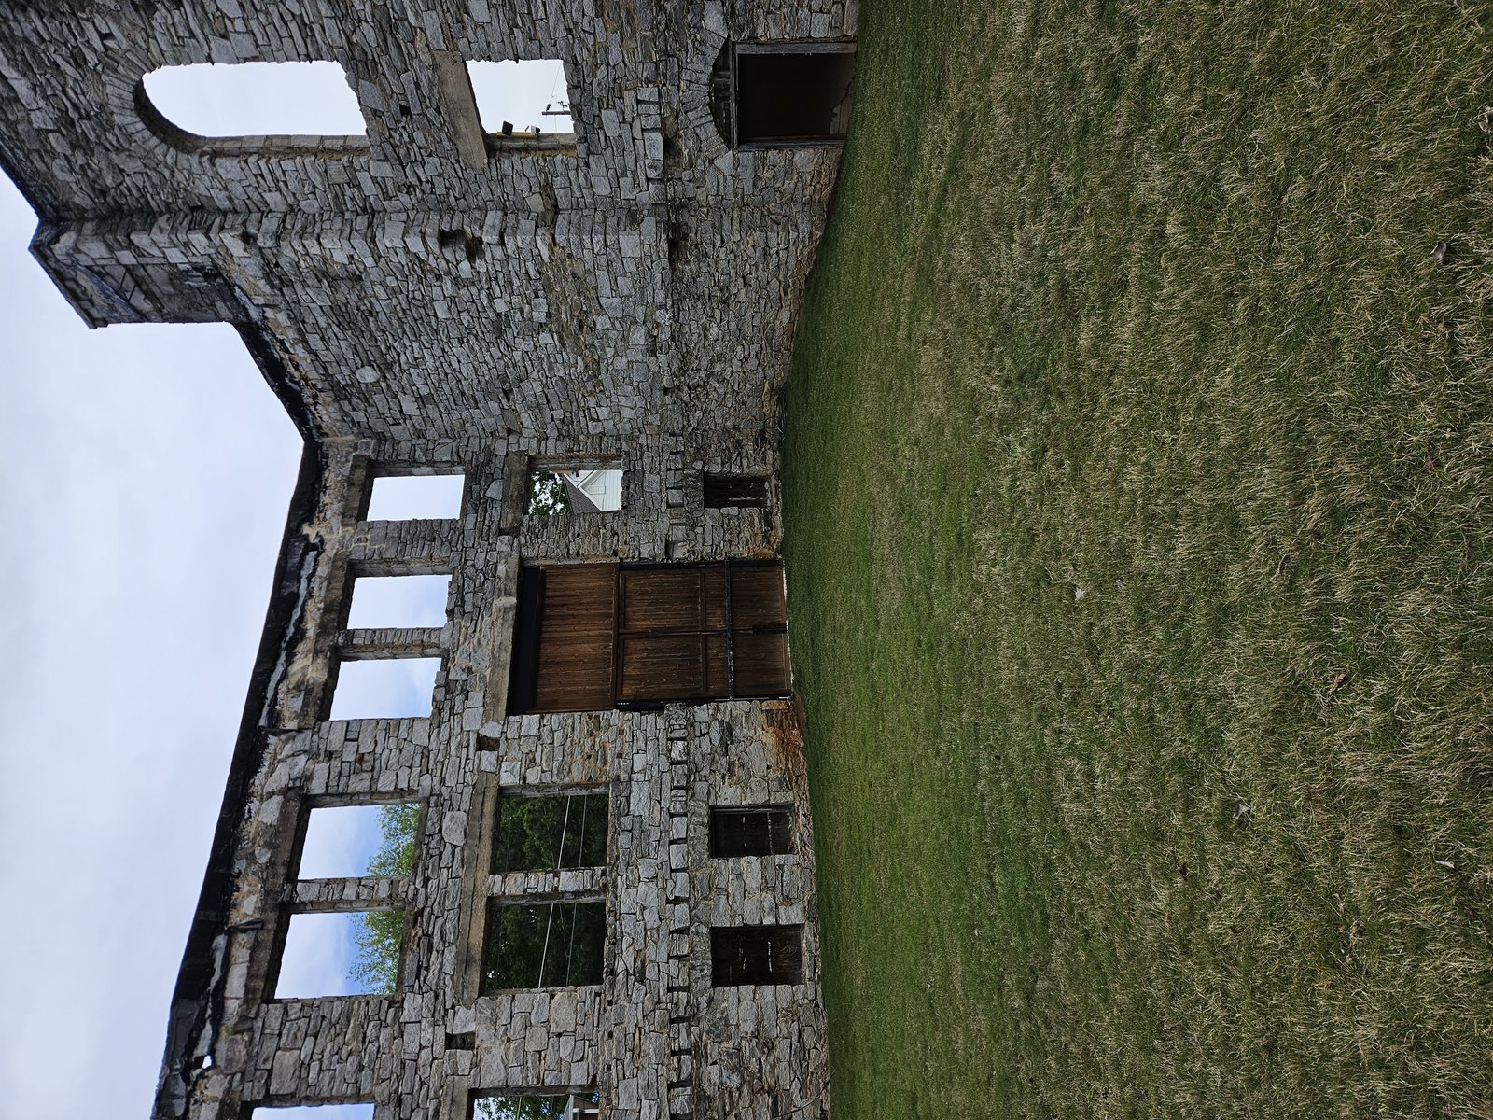
LET'S MAKE HISTORY TOGETHER
Sponsor an event series. Rent the space. Be part of a story.
The Mark is open — and there's nothing else like it in Atlanta.
Sponsor an Event
Rent the Venue
Learn More
Ready to get started? Contact us today:
Old St. Mark's AME Church
English Avenue · Historic Westside · Atlanta, Georgia
hello@bestsideatl.com · 404-518-3596·

